Slide 1
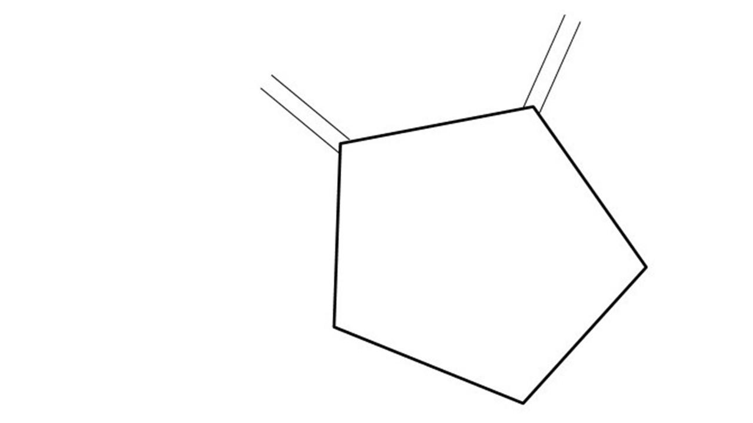
Great Cow BASIC
ASM three ways
Feb 2021

Slide 2
Overview
Great Cow BASIC supports ASM
Great Cow BASIC generates ASM for PIC, AVR & LGT
You can use ASM directly in your program
Compiler will pre-process basic instructions
Compiler will assemble complex instructions
Compiler will pass instructions direct to assembler

Slide 3
The core compiler
High Level Language
Reports:
TXT and HTML
Source Code
Great Cow BASIC Compiler
Great Cow BASIC Compiler
Preprocessor
Code Translator
Assembler
Linker
Assembly Language
ASM file
Absolute Machine Code
HEX file
Libraries
8 bit PIC and AVR

Slide 4
1. Pre-process basic instructions
Just include instructions etc in source
;Display = 8
MOVLW 8
MOVWF DISPLAY,ACCESS
Basic instructions work easily
Leverage Great Cow BASIC memory management

Slide 5
2. Assemble complex instructions
Include instructions etc in source
Lead with `ASM`
;CLRF TRISC
CLRF TRISC,ACCESS
;MOVLW 0x08
MOVLW 8
;ASM MOVWF Display,ACCESS
MOVWF DISPLAY,ACCESS
Instruction need to use ACCESS and BANKED
Variables need to initialized

Slide 6
3. Pass instructions direct to assembler
Include instructions etc in source
Lead with `#ASMRAW `
#ASMRAW CLRF TRISC
#ASMRAW MOVLW 0x08
#ASMRAW MOVWF Display
Instruction need to handle all syntax
Variables need to defined using #define

Slide 7
Compare ASM methods
Method | Up’s | Down’s
Just use Great Cow BASIC syntax | Very Portable code Optimised code for chip and config Self documenting Simple | Uses more PROGMEM than asm instructions
Just insert instructions | Leverages Great Cow BASIC memory management and logic control Self documenting | Uses less PROGMEM Chip family specific solution Timing, timers need to be managed
ASM Instruction | Permits range of ASM instructions with some Great Cow BASIC logic control (labels etc) | Uses less PROGMEM Chip family specific solution Timing, timers need to be managed Does not support Great Cow BASIC memory management
#ASMRAW | Permits full range of ASM instructions | # All of above plus any ASM instruction will assembled blindly

Slide 8
Lab
Method
Just use Great Cow BASIC syntax | Baseline creates portable ASM source Baseline with 197 ms delay
ASM Instruction | CLRF TRISC MOVLW 0x08 ASM MOVWF Display,ACCESS
#ASMRAW | #ASMRAW CLRF TRISC #ASMRAW MOVLW 0x08 #ASMRAW MOVWF Display

Slide 10
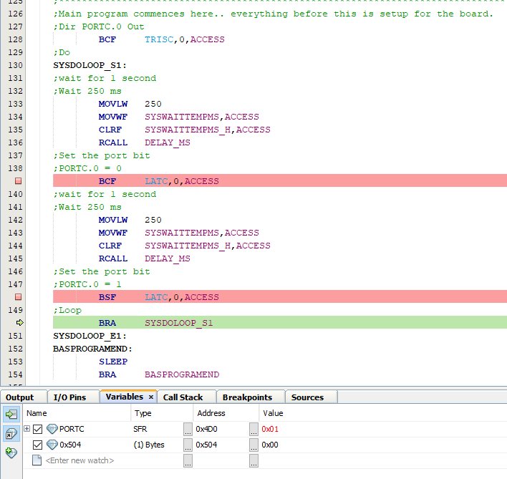
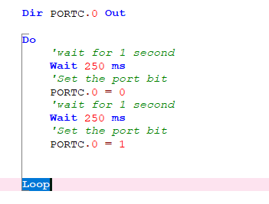
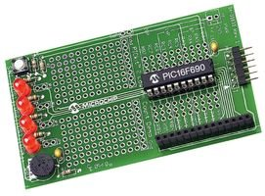

Great Cow BASIC

Slide 11
Great Cow BASIC
Great Cow BASIC for the PIC18FxxQ41 chip Family
January 2021

